Slide 1
Sparse generalized dissimilarity modeling: addressing the "curse of dimensionality" in GDMs
GDM Workshop
Day 4
Instructor: Jacob Nesslage

Slide 2
Check-in!
How has your own analysis using generalized dissimilarity modeling been going?
Let’s discuss your analysis, your data wrangling struggles, and other issues…

Slide 3
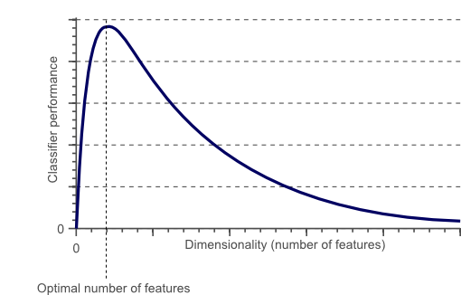
The “Curse of Dimensionality” in modeling
The curse of dimensionality refers to various phenomena that arise when analyzing and organizing data in high-dimensional spaces that do not occur in low-dimensional settings such as the three-dimensional physical space of everyday experience.
Dimensionally cursed phenomena occur in. domains such as numerical analysis, sampling, combinatorics, machine learning, data mining and databases.
The common theme of these problems is that when the dimensionality increases, the volume of the space increases so fast that the available data become sparse.

Slide 4
The “curse of dimensionality” necessitates the need for sparse GDMs
The use of high-dimensional continuous remotely sensed information, such as imaging spectroscopy data or time series data, has been shown to be useful for characterizing species distributions.
Yet, the high-dimensional (and potentially multicollinear) nature of these data poses challenges for analysis, which typically results in loss of model performance and generalization.
To deal with this issue, we need additional tools to deal with this for GDM. The solution is Sparse Generalized Dissimilarity Modeling!

Slide 5
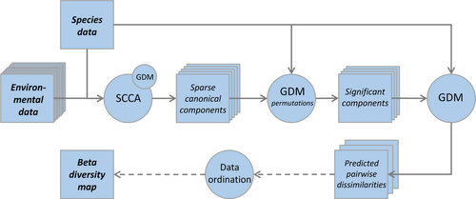
Sparse GDM
Essentially, Sparse GDM is a GDM that has a few extra steps prior to model training:
Data is fed through a sparse canonical correspondence analysis (SCCA)
The output is a raster stack of a pre-defined number of sparse canonical components (similar to PCA)
These components an additional data reduction step. This is done by testing the significance of the input variable (sparse components) contribution, through matrix permutation, subsequently eliminating the non-significant variables
These are then fed into the GDM framework we previously discussed

Slide 6
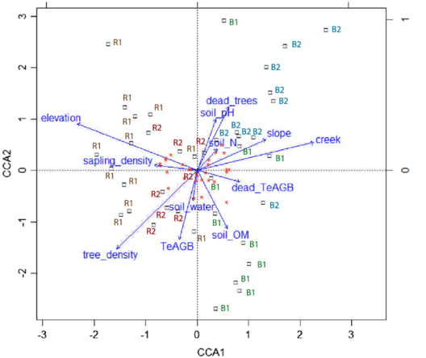
What is Canonical Correspondence Analysis?
Canonical Correspondence Analysis (CCA) is a multivariate statistical technique used for analyzing the relationships between sets of categorical or continuous variables in ecological and environmental research.
Implementation steps:
Gather species and environmental matrices
Standardize data (mean = 0, sd =1)
Perform correspondence analysis, which yield eigenvectors and eigenvalues describing variation in species data
Then, CCA seeks linear combinations of the environmental variables that are most correlated with the linear combinations of the species data. The result is a set of canonical axes.

Slide 7
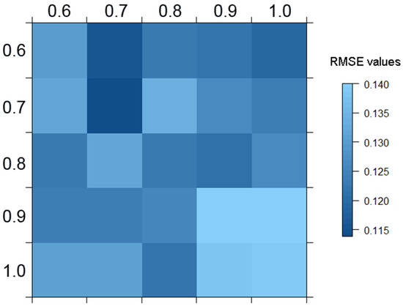
What makes Sparse CCA different?
Sparse Canonical Correspondence Analysis (SCCA) is a variation of Canonical Correspondence Analysis (CCA) that incorporates sparsity constraints into the analysis.
The key difference between SCCA and traditional CCA lies in how the relationships between species and environmental variables are modeled and represented.
Let's explore the differences between the two:

Slide 8
Incorporation of Sparsity Constraints:
Traditional CCA: In traditional CCA, the canonical axes are linear combinations of both species and environmental variables. All variables contribute to the axes, which can make interpretation complex when dealing with high-dimensional datasets or noisy variables.
Sparse CCA: In SCCA, the canonical axes are constrained to have only a subset of variables contributing significantly to them. This means that SCCA emphasizes a smaller set of important variables, potentially reducing overfitting and aiding in interpretation.
Feature Selection and Dimensionality Reduction:
Traditional CCA: Traditional CCA doesn't inherently perform variable selection or dimensionality reduction. It includes all variables in the analysis, which can be challenging when dealing with a large number of variables.
Sparse CCA: SCCA automatically selects a subset of relevant variables that contribute most to the canonical axes. This feature selection aspect helps in reducing the dimensionality of the analysis while retaining the most informative variables.
Interpretation:
Traditional CCA: Interpreting canonical axes in traditional CCA can be complex due to the involvement of all variables. The relationships between species and environmental variables might not be as easily discernible.
Sparse CCA: The sparsity constraints in SCCA result in canonical axes that involve a reduced set of variables. This can make the interpretation more straightforward, as the focus is on the key variables driving the associations between species and the environment.
Regularization:
Traditional CCA: Traditional CCA does not inherently involve regularization techniques. It does not explicitly handle issues related to multicollinearity or overfitting.
Sparse CCA: SCCA incorporates regularization techniques to encourage sparsity. These techniques penalize the contribution of variables that are not highly relevant to the canonical axes, which can improve the stability of the results.
Applications:
Traditional CCA: Traditional CCA is well-suited for situations where a comprehensive overview of all variables is desired and where the number of variables is not too high.
Sparse CCA: SCCA is particularly useful when dealing with high-dimensional datasets, where many variables might be noisy or redundant. It helps to focus on the most important variables for interpreting the relationships.

Slide 9
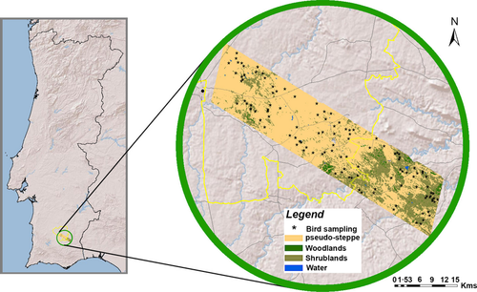
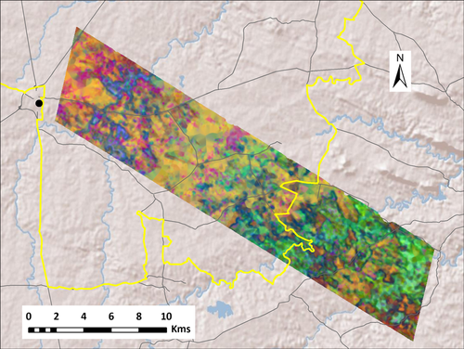
Example: GDM using Landsat Time Series

Slide 10

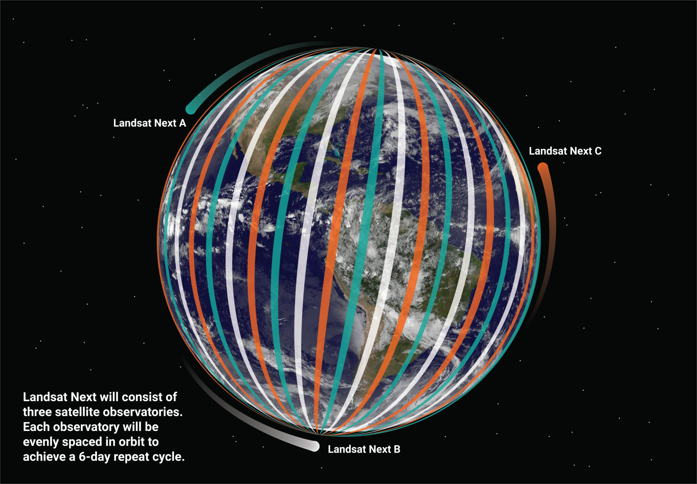
Why is this important?
As next-generation remote sensing platforms move to an imaging spectroscopy focus, we will need techniques such as SGDM to deal with these datasets.
We also have incredible time-series data currently available to exploit. Seasonality and phenology matters quite a bit, but is difficult to incorporate. SGDM can help with this if the goal is to model variation in beta diversity.

